Slide 1

Computer Organization & Architecture
TSEC
Today, we're kicking off an exciting journey into the fundamental building blocks of how computers work. This will give you a roadmap of the exciting concepts we'll delve into, from bits and bytes to CPUs and memory.

Slide 2
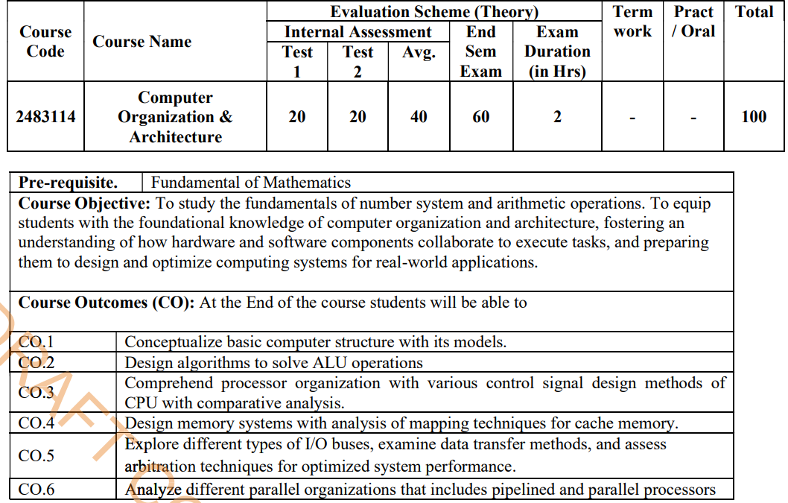

Slide 3
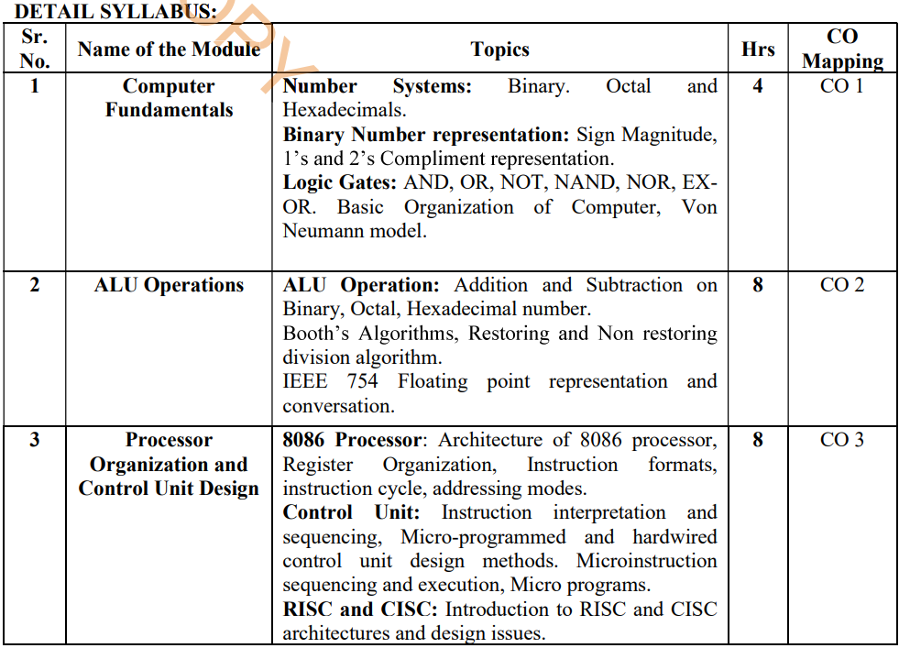

Slide 4
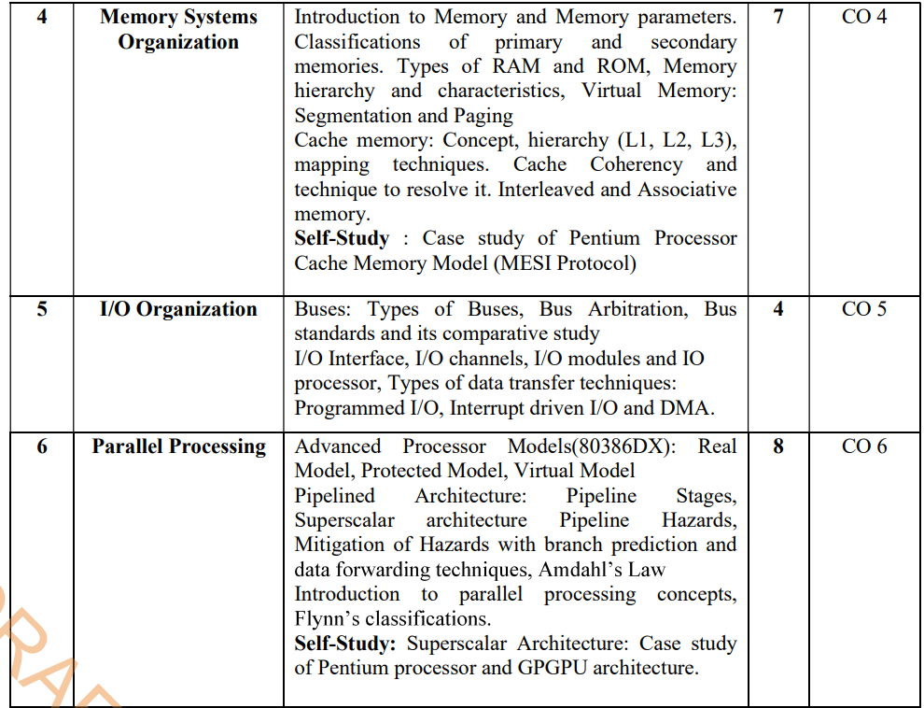

Slide 5
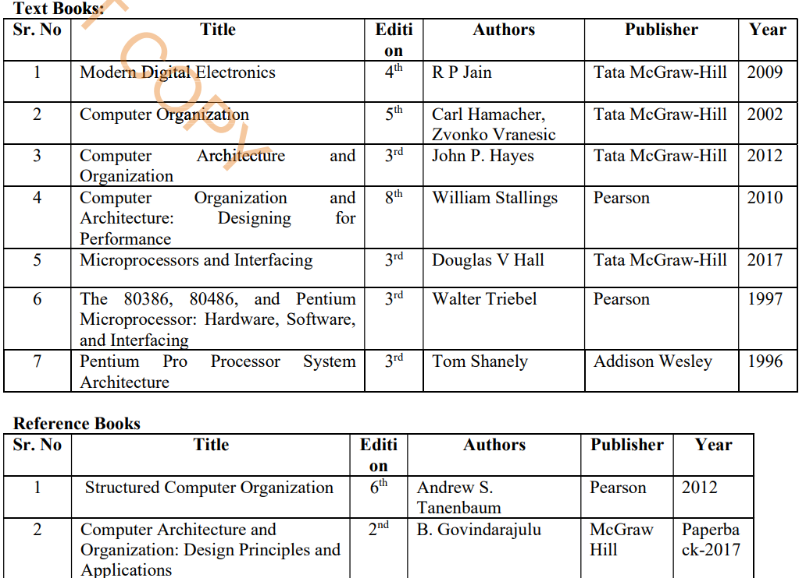

Slide 6
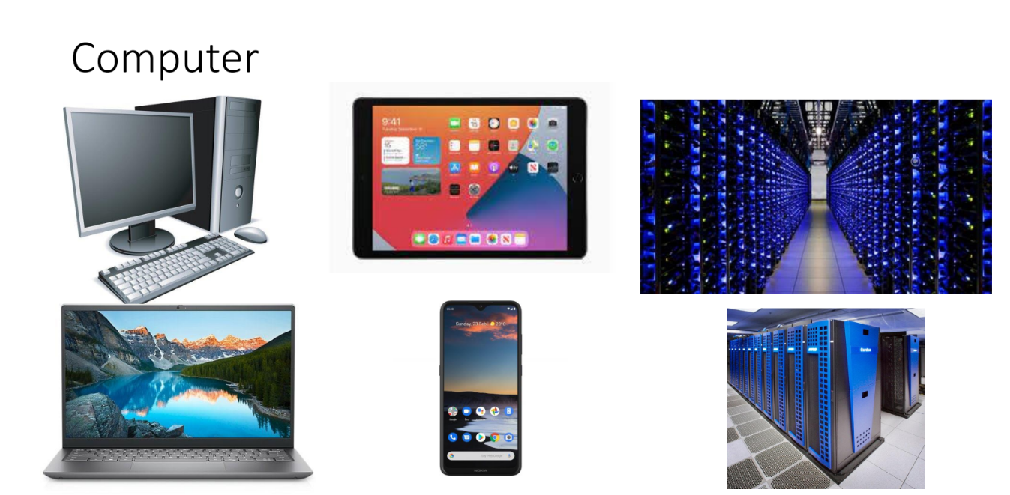

Slide 7
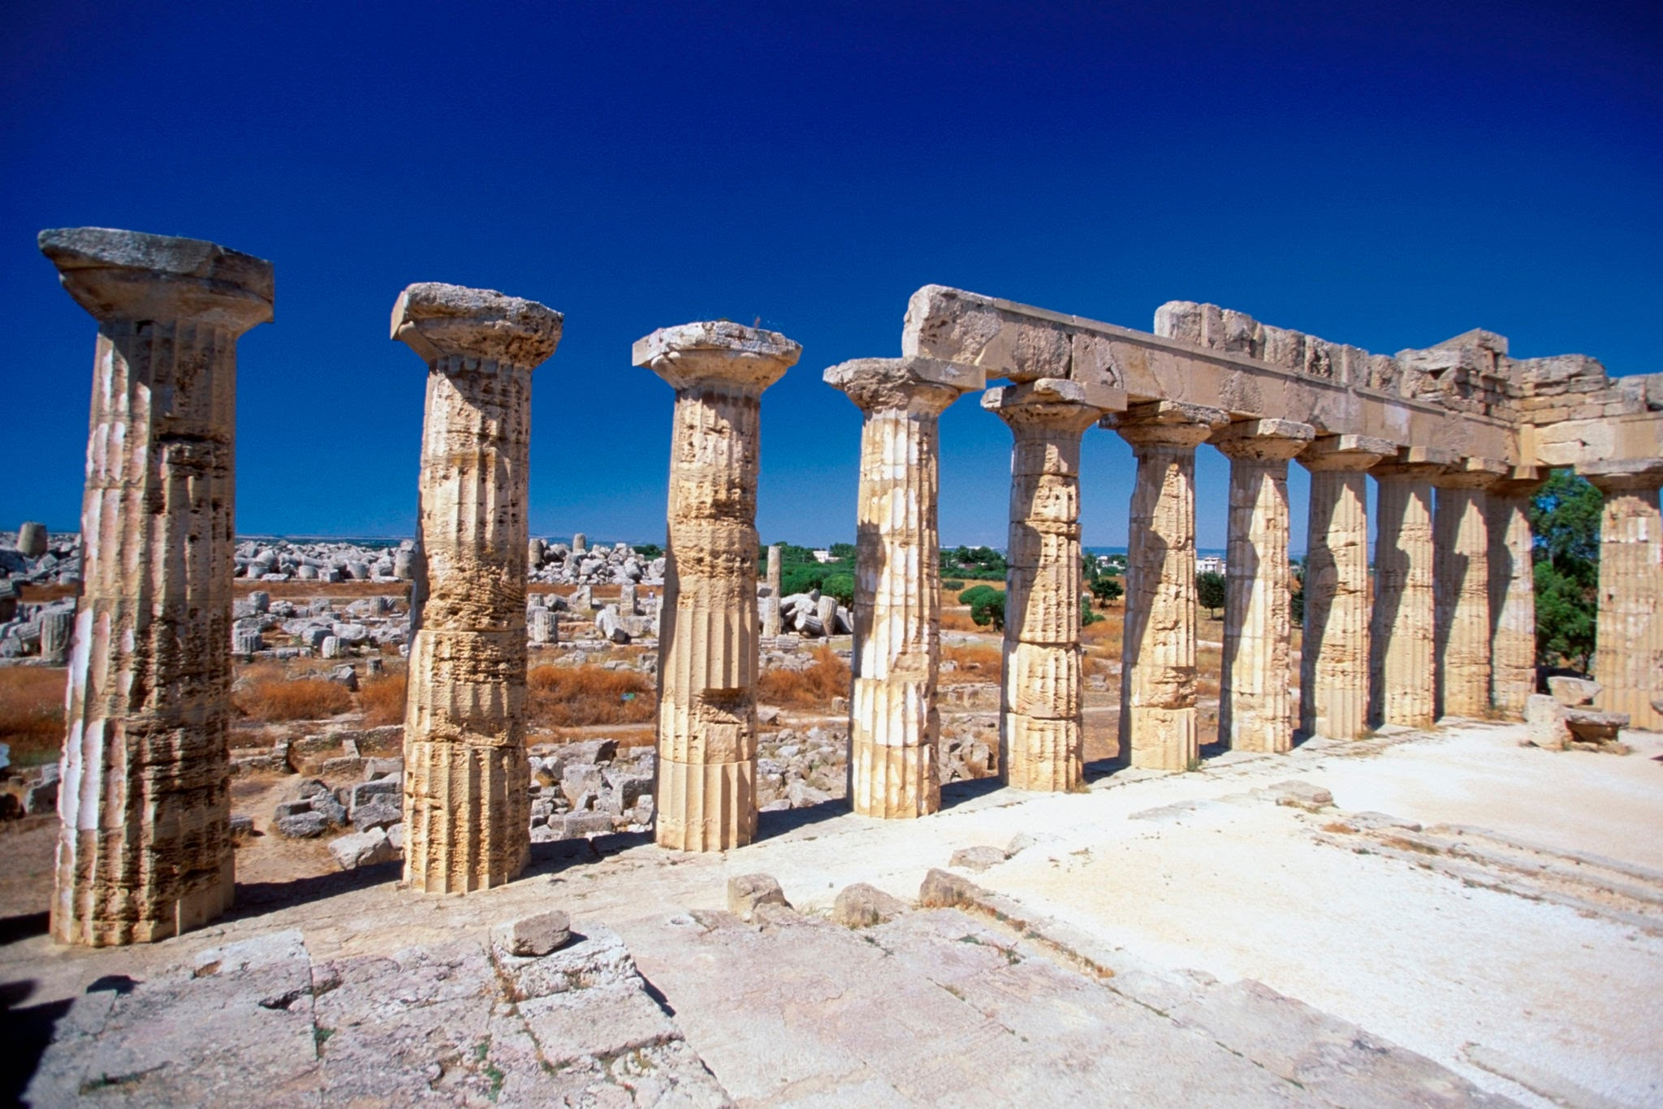



Architecture

Slide 8
Computer Architecture
Think of it like the blueprint for a building: it outlines the structure, the layout of rooms, how utilities are connected, and how different parts will function together to meet the user's needs.
Definition

Slide 9
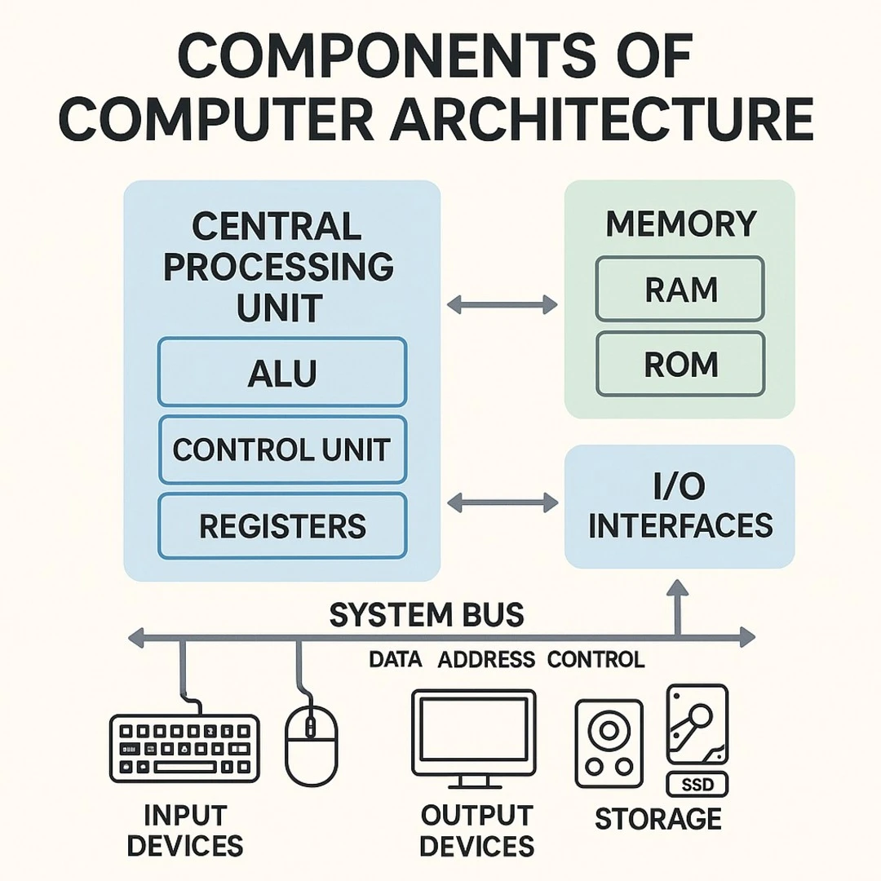
Similar Way…
Computer architecture refers to the design and structure of a computer system, including its components like the CPU, memory, and input/output (I/O) subsystems, and how they interact. It essentially defines how hardware and software work together to create a functional computer.

Slide 10
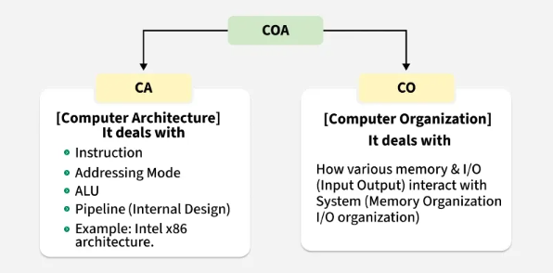
It is about how the components of a computer system, like the CPU, memory, and input/output devices, are connected and work together to execute programs.
It is high level design and functional behavior of a computer system, mostly from the point of view of a programmer including the Instruction Set Architecture (or ISA), addressing modes, logic design, and implementation

Slide 11
Octal Addition
ALU Operations - OCTAL ARITHMETIC
+ | 0 | 1 | 2 | 3 | 4 | 5 | 6 | 7
0
1
2
3
4
5
6
7

Slide 12
Octal Addition
+ | 0 | 1 | 2 | 3 | 4 | 5 | 6 | 7
0 | 0
1 | 1
2 | 2
3 | 3
4 | 4
5 | 5
6 | 6
7 | 7

Slide 13
Octal Addition
+ | 0 | 1 | 2 | 3 | 4 | 5 | 6 | 7
0 | 0 | 1
1 | 1 | 2
2 | 2 | 3
3 | 3 | 4
4 | 4 | 5
5 | 5 | 6
6 | 6 | 7
7 | 7 | 10

Slide 14
Octal Addition
+ | 0 | 1 | 2 | 3 | 4 | 5 | 6 | 7
0 | 0 | 1 | 2
1 | 1 | 2 | 3
2 | 2 | 3 | 4
3 | 3 | 4 | 5
4 | 4 | 5 | 6
5 | 5 | 6 | 7
6 | 6 | 7 | 10
7 | 7 | 10 | 11

Slide 15
Octal Addition
+ | 0 | 1 | 2 | 3 | 4 | 5 | 6 | 7
0 | 0 | 1 | 2 | 3
1 | 1 | 2 | 3 | 4
2 | 2 | 3 | 4 | 5
3 | 3 | 4 | 5 | 6
4 | 4 | 5 | 6 | 7
5 | 5 | 6 | 7 | 10
6 | 6 | 7 | 10 | 11
7 | 7 | 10 | 11 | 12

Slide 16
Octal Addition
+ | 0 | 1 | 2 | 3 | 4 | 5 | 6 | 7
0 | 0 | 1 | 2 | 3 | 4
1 | 1 | 2 | 3 | 4 | 5
2 | 2 | 3 | 4 | 5 | 6
3 | 3 | 4 | 5 | 6 | 7
4 | 4 | 5 | 6 | 7 | 10
5 | 5 | 6 | 7 | 10 | 11
6 | 6 | 7 | 10 | 11 | 12
7 | 7 | 10 | 11 | 12 | 13

Slide 17
Octal Addition
+ | 0 | 1 | 2 | 3 | 4 | 5 | 6 | 7
0 | 0 | 1 | 2 | 3 | 4 | 5
1 | 1 | 2 | 3 | 4 | 5 | 6
2 | 2 | 3 | 4 | 5 | 6 | 7
3 | 3 | 4 | 5 | 6 | 7 | 10
4 | 4 | 5 | 6 | 7 | 10 | 11
5 | 5 | 6 | 7 | 10 | 11 | 12
6 | 6 | 7 | 10 | 11 | 12 | 13
7 | 7 | 10 | 11 | 12 | 13 | 14

Slide 18
Octal Addition
+ | 0 | 1 | 2 | 3 | 4 | 5 | 6 | 7
0 | 0 | 1 | 2 | 3 | 4 | 5 | 6
1 | 1 | 2 | 3 | 4 | 5 | 6 | 7
2 | 2 | 3 | 4 | 5 | 6 | 7 | 10
3 | 3 | 4 | 5 | 6 | 7 | 10 | 11
4 | 4 | 5 | 6 | 7 | 10 | 11 | 12
5 | 5 | 6 | 7 | 10 | 11 | 12 | 13
6 | 6 | 7 | 10 | 11 | 12 | 13 | 14
7 | 7 | 10 | 11 | 12 | 13 | 14 | 15

Slide 19
Octal Addition
+ | 0 | 1 | 2 | 3 | 4 | 5 | 6 | 7
0 | 0 | 1 | 2 | 3 | 4 | 5 | 6 | 7
1 | 1 | 2 | 3 | 4 | 5 | 6 | 7 | 10
2 | 2 | 3 | 4 | 5 | 6 | 7 | 10 | 11
3 | 3 | 4 | 5 | 6 | 7 | 10 | 11 | 12
4 | 4 | 5 | 6 | 7 | 10 | 11 | 12 | 13
5 | 5 | 6 | 7 | 10 | 11 | 12 | 13 | 14
6 | 6 | 7 | 10 | 11 | 12 | 13 | 14 | 15
7 | 7 | 10 | 11 | 12 | 13 | 14 | 15 | 16

Slide 20
Hexadecimal Addition
+ | 0 | 1 | 2 | 3 | 4 | 5 | 6 | 7 | 8 | 9 | A | B | C | D | E | F
0 | 0 | 1 | 2 | 3 | 4 | 5 | 6 | 7 | 8 | 9 | A | B | C | D | E | F
1 | 1 | 2 | 3 | 4 | 5 | 6 | 7 | 8 | 9 | A | B | C | D | E | F | 10
2 | 2 | 3 | 4 | 5 | 6 | 7 | 8 | 9 | A | B | C | D | E | F | 10 | 11
3 | 3 | 4 | 5 | 6 | 7 | 8 | 9 | A | B | C | D | E | F | 10 | 11 | 12
4 | 4 | 5 | 6 | 7 | 8 | 9 | A | B | C | D | E | F | 10 | 11 | 12 | 13
5 | 5 | 6 | 7 | 8 | 9 | A | B | C | D | E | F | 10 | 11 | 12 | 13 | 14
6 | 6 | 7 | 8 | 9 | A | B | C | D | E | F | 10 | 11 | 12 | 13 | 14 | 15
7 | 7 | 8 | 9 | A | B | C | D | E | F | 10 | 11 | 12 | 13 | 14 | 15 | 16

Slide 21
START
BOOTH’s Algorithm Flowchart
M <- Multiplicand
Q <- Multiplier
q₀ <- 0
A<- o
n <- no. of Bits
10
q₁ q₀
01
A <- A-M
A <- A+M
11 / 00
Arithmetic Shift Right AQq₀
n <- n-1
Is n=0?
NO
YES
Result in AQ
STOP

Slide 22
Hardware Implementation of Booth’s Algorithm
BR Register
Sequence Counter
Complimenter And Parallel Adder
Q_{n}
Q_{n + 1}
AC Register
QR Register

Slide 23
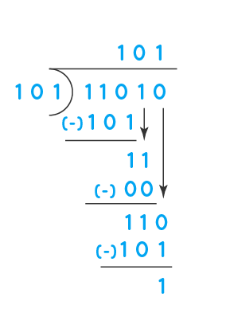
Division Algorithms
Slow Division Fast Division

Slide 24
START
Restoring Algorithm Flowchart
M <- Divisor
Q <- Dividend
A<- o
n <- no. of Bits (x)
Result:
Quotient Q Remainder A
Shift Left AQ
STOP
A <- A-M
NO
YES
0
A[n]? Sign bit
Is n=0?
1
Q_{[0]}<- 0
Restore A
Q_{[0]}<- 1
n = n -1

Slide 25
Non-Restoring Algorithm Flowchart
START
STOP
Quotient in Q
Remainder in A
M <- Divisor
Q <- Dividend
A<- o
n <- no. of Bits (x)
A <- A + M
0
0
A[n]? Sign bit
1
A[n]? Sign bit
1
Shift Left AQ
A <- A - M
Shift Left AQ
A <- A + M
NO
YES
0
A[n]? Sign bit
1
Q₀ = 1
Is n=0?
Q₀ = 0
n = n -1

Slide 26
Floating Point Number Representation
2 ways of representing decimal nos :
1. Fixed point representation
The usual way of representing numbers is to write the number with the decimal point fixed in it’s correct position between the 2 appropriate digits eg : 13.75 or 345.78
This is called fixed point representation.
Drawback:
This representation becomes cumbersome when dealing with several very large or very small numbers.
eg: 0.00000001375
or 1375000000000

Slide 27
Floating Point Number Representation
2. Floating point representation
Three numbers associated with a floating point number are :
a. Mantissa M
b. Exponent E
c. Base B
These three numbers together represent the real number M x B^{E}
Eg : 1.0 x 10¹⁸
1.0- Mantissa
18- Exponent
10- Base
Base B – constant,
Therefore a floating point number is stored as (M,E)

Slide 28
Floating Point Number Representation - Example
Suppose that M and E are both 3-bit sign and magnitude
integers and B=2
M and E each can assume the values +/-0 , +/-1, +/-2 and +/-3.
All binary words of the form (M,E) = (x00,xxx) represent zero where x denotes either 0/1.
The smallest non zero positive number is :
(001,111)= 1 x 2⁻³ = 0.125
The smallest non zero negative number is :
(101,111)= -1 x 2⁻³ = -0.125
The largest representable positive number is :
(011,011)= 3 x 2³=24
The largest representable negative number is :
(111,011)= -3 x 2³ = -24
Note : The leftmost bit which is the sign of the mantissa is also the sign of the floating point number

Slide 29
An example of a floating point number in binary format (32 bit)
Assumptions :
Implied base 2.
7-bit signed exponent is expressed as a 2’s complement integer.
Left most bit represents sign of the number (0 means + ,1 means -)
S bit | 7 –bit signed exponent | 24-bit fractional mantissa
The 24 bit mantissa is considered to be a fraction with the binary point at its left end .
To retain as many significant bits as possible, the fractional mantissa is kept in a normalized form i.e it’s leftmost bit is always 1.

Slide 30
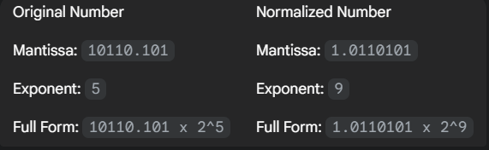
Example
Both 10110.101 x 2^5 and 1.0110101 x 2^9 represent the exact same numerical value, but the latter is in the standard normalized form.

Slide 31
}Hence a 7-bit 2’s complement exponent has a range of --à
2^{n-1} -1 to -2^{n-1}
2^6-1 to -2^6
+63 to -64
Some computers employ a different type of representation for exponents i.e. biased exponent representation
Here the n-bit exponent is expressed in excess 2^{(n-1)} format.
Hence the 7-bit exponent is expressed in excess 64 format.
In this representation the sign bit is removed from being a separate entity.
A (+) no. called bias (64) is added to each exponent as the floating point number is formed, so that internally all exponents are positive.

Slide 32
E’ ---new exponent
E’ = E + 64
Since -64 ≤ E ≤ +63
0 ≤ E’ ≤ +127
-64 is represented as ------- 0000000
-63 is represented as ------- 0000001
-62 is represented as ------- 0000010
“ “
“ “
0 is represented as ------- 1000000
1 is represented as ------- 1000001
“ “
+63 is represented as ------- 1111111

Slide 33
IEEE 754 Floating point number format
The IEEE Standard for Floating-Point Arithmetic (IEEE 754) is a technical standard established by the Institute of Electrical and Electronics Engineers (IEEE) and the most widely used standard for floating-point computation, followed by many CPU.
IEEE 754 defines 2 standards
1. Single precision no. (32 bits)
2. Double precision no. (64 bits)

Slide 34
IEEE 754 Single precision
The standard for a 32 bit floating point number is ----
1. Sign bit S
2. 8 bit exponents field E’ (in excess 127 representation) i.e the bias added here is 2^{n-1} -1
3. 23-bit mantissa field M
4. Base 2
8 bit signed exponent in excess 127 representation
S bit | E’ | M
Sign of the number
0 ----- +
1 ----- -
23 bit fractional mantissa

Slide 35
IEEE 754 Single precision
Since E varies from
-2^{n-1}+1 to 2^{n-1} i .e -127 ≤ E ≤ +128
E’ = E + 127
0 ≤ E’ ≤ +255
E E’
-127 00000000 represents the floating point no. zero
-126 00000001
0 01111111
1 10000000
+128 11111111 represents ∞

Slide 36
IEEE 754 Single precision
Normalization in IEEE 754
In IEEE 754 format the mantissa is actually of the form 1.M where 1 is to the left of the binary point .
This I is implicit/hidden and is not stored along with the number but assumed to be there.
Use of hidden 1 means that the precision of a normalized number is effectively increased by 1 bit.

Slide 37
IEEE 754 Single precision
0 | 00101000 | 001010……..0
Value represented ---à M= 1.001010
E’= 40
E=E’-127 = 40 – 127 = -87
1.001010… X 2⁻⁸⁷
Hence in IEEE 754 format the actual value of N
N= (-1)^{S} 2 ^{E’-127} X (1.M)

Slide 38
IEEE 754 Double precision
11 bit signed exponent in excess 1023 representation
S bit | E’ | M
-1023 ≤ E ≤ +1024
E’ = E + 1023
0 ≤ E’ ≤ +2047
Here the actual value of N is
N= (-1)^{S} 2 ^{E’-1023} X (1.M)
Sign of the number
0 ----- +
1 ----- -
52 bit fractional mantissa

Slide 39
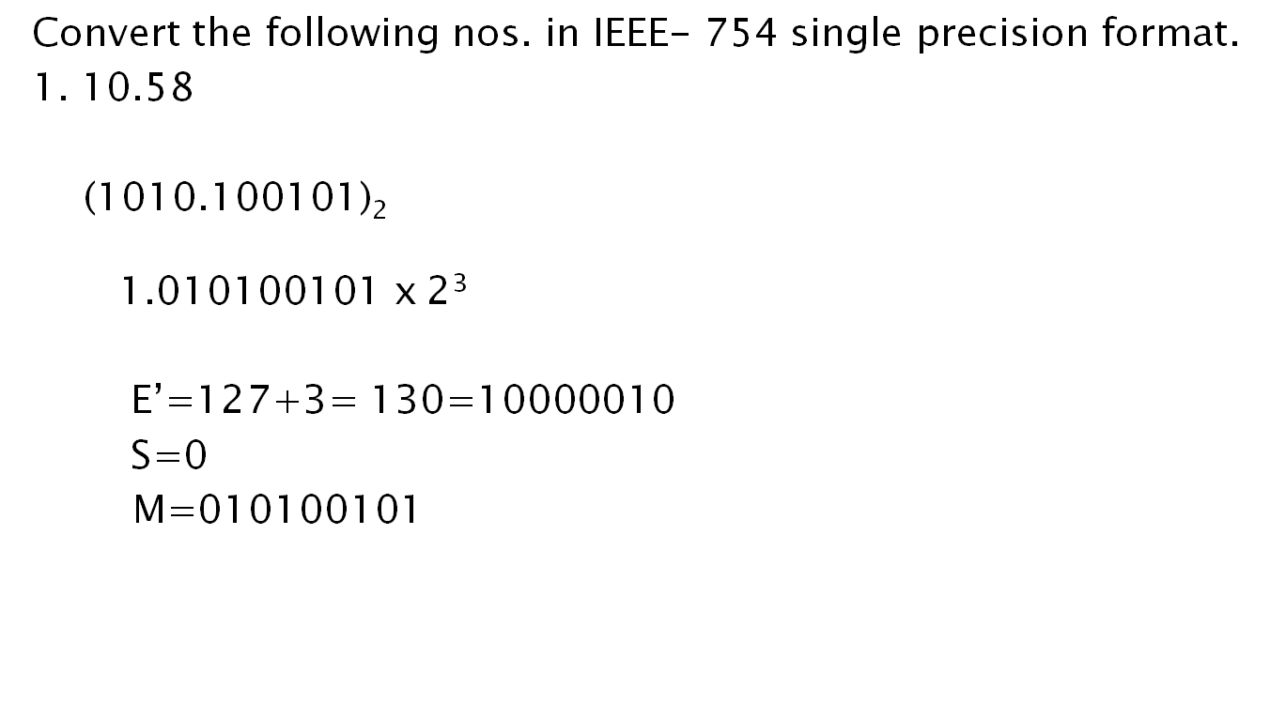
0 | 10000010 | 010100101

Slide 40
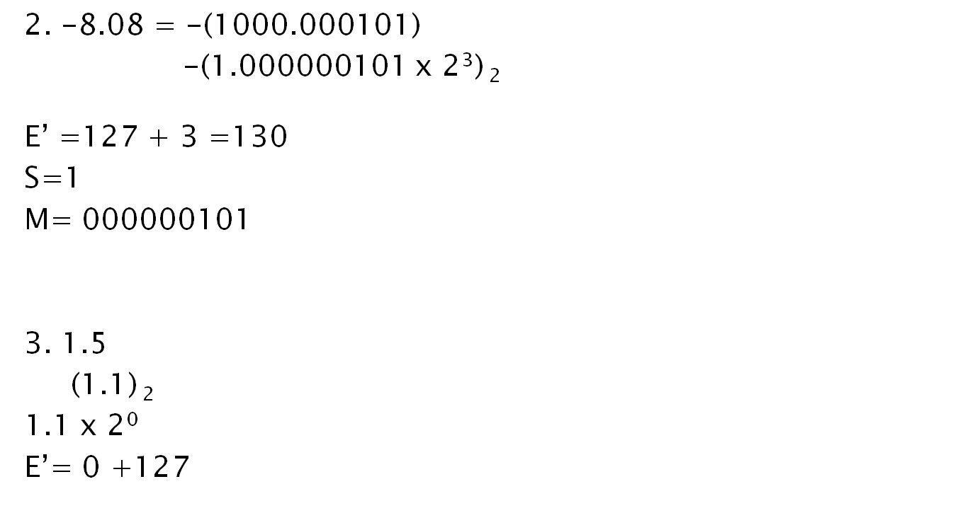
0 | 10000010 | 000000101…..
0 | 01111111 | 10…..0

Slide 41
